Slide 1
More on Recursion
Lecture #
By: Abdul Aleem.

Slide 2



Contents
1
Example on Recursion
2
Recursive Helper Method
3
Types of Recursion

Slide 3
Understanding Recursion with an Example
Example 2: To compute gcd of 2 +ve integers
Euclid’s algorithm for gcd computation is as follows:
Table 1: gcd computation
iteration | a | b | r = a%b
1 | 18 | 28 | 18
2 | 28 | 18 | 10
3 | 18 | 10 | 8
4 | 10 | 8 | 2
5 | 8 | 2 | 0
6 | 2 | 0 | -

Slide 4
Understanding Recursion with an Example
Algorithm 1 gcd (a, b)
Require: a positive integers a and b.
Ensure: compute gcd of a and b.
1: if b == 0 then
2: return a
3: else
4: return gcd (b, a%b)
5: end if

Slide 5
Understanding Recursion with an Example
main()
 | calls
gcd(18,28)
 | calls
gcd(28,18)
 | calls
gcd(18,10)
 | calls
gcd(10,8)
 | calls
gcd(8,2)
 | calls
gcd(2,0)
main()
 | returns 2
gcd(18,28)
 | returns 2
gcd(28,18)
 | returns 2
gcd(18,10)
 | returns 2
gcd(10,8)
 | returns 2
gcd(8,2)
 | returns 2
gcd(2,0)
Figure 1: Recursion process for gcd

Slide 6
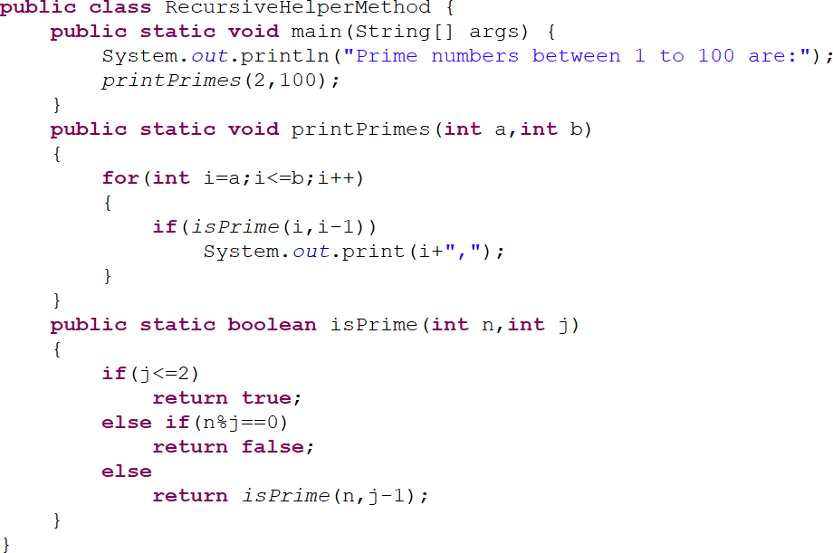
Recursive Helper Method
A recursive helper method is a recursive method that is called by another, usually non-recursive, method.
Figure 2: Recursive Helper Method

Slide 7
Types of Recursion
Recursion is mainly of two types depending on whether a method calls itself within its body or two methods call one another mutually.
Direct recursion: a method calls itself within its body.
Indirect recursion: two methods call one another.
Algorithm 3 shows an example (to print numbers from 1 to n) of direct recursion. The Figure 3 displays the solution of the same problem using indirect recursion.

Slide 8
Types of Recursion
Algorithm 2 print (n) //Direct Recursion
Require: a positive integers n. Ensure: print numbers from 1 to n. 1: if n == 0 then
2: return;
3: else
4: print (n − 1);
5: System.out.print(n+” ”);
6: end if

Slide 9
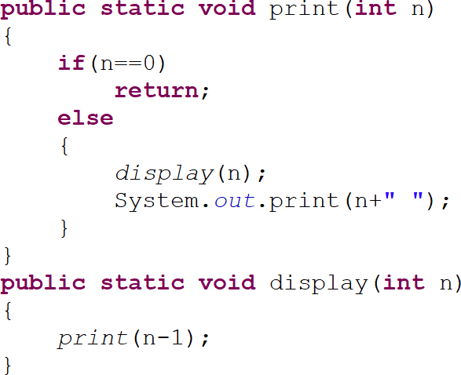
Types of Recursion
Figure 3: Indirect Recursion - to print numbers from 1 to n

Slide 10
References
Y Daniel Liang ‘Introduction to JAVA Programming, Comprehensive Version’,
Pearson, 2014.

